Slide 1
OCEAN IN TIMEs OF INTENSE CHANGE
Pei Sun Loh, Ocean College, Zhejiang University
7 May 2026

Slide 2
Lecture 1.2: Climate change indicators

Slide 3
OCEAN HEAT
The world’s oceans absorb some of heat energy from the sun
Global ocean heat content (OHC) increased from 1955 to 2015
Mostly caused by anthropogenic greenhouse gas emissions

Slide 4
Accumulation of heat in the ocean – increase ocean temperature
Ocean’s thermal expansion - increase volume of water
Major contribution to sea level rise
Anthropogenic climate change

Slide 5
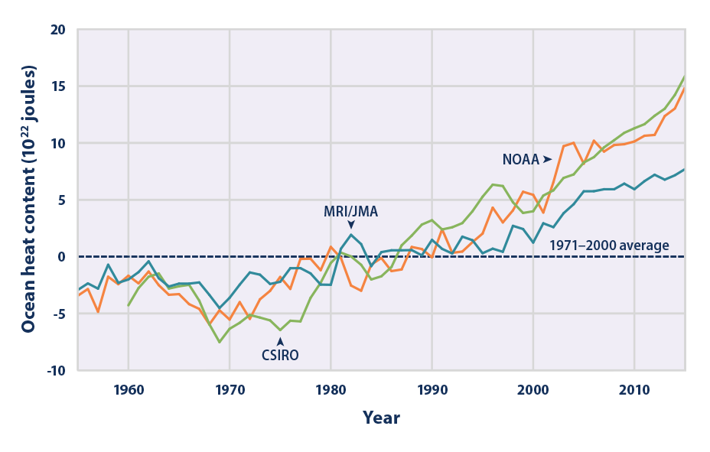

Slide 6
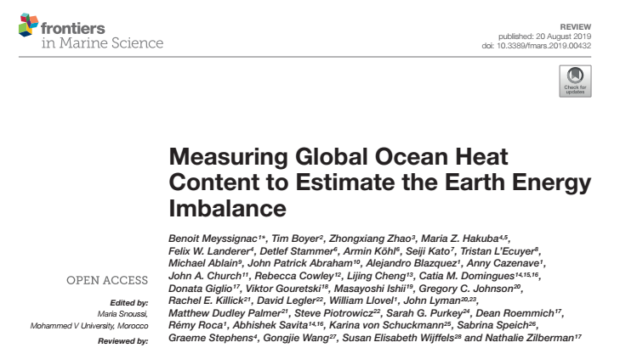

Slide 7
Methods to measure OHC:
direct observations of in situ temperature
satellite-based measurements of the ocean surface net heat fluxes
satellite-based estimates of the thermal expansion of the ocean
ocean analyses that assimilate observations from both satellite and in situ instruments

Slide 8
SEA SURFACE TEMPERATURE
Temperature of the water at the ocean surface
Continues to rise from 1901 to 2015

Slide 9
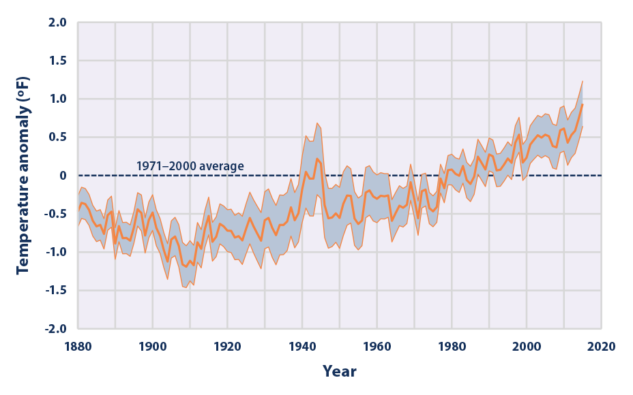

Slide 10
Increased bioaccumulation …
Since 1970s, there has been more than 50% increase of methylmercury in the tissues of the Atlantic blue fin tuna due to increased seawater temperature
Fish are predominant source of human exposure to methylmercury

Slide 11
Marine heatwave
Caused mass mortalities, harmful algae bloom, decline in kelp bed and changes in species distribution
Great Barrier Reef experienced heatwave in 2016

Slide 12
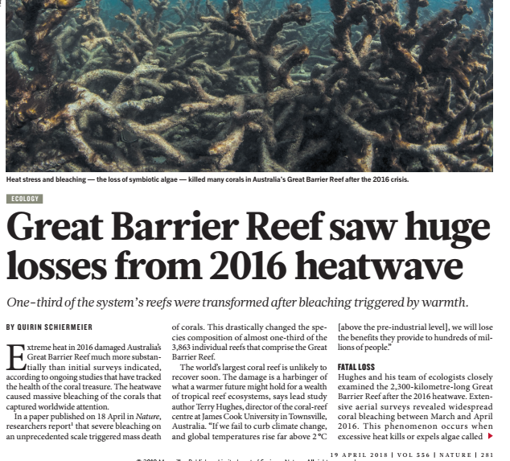

Slide 13
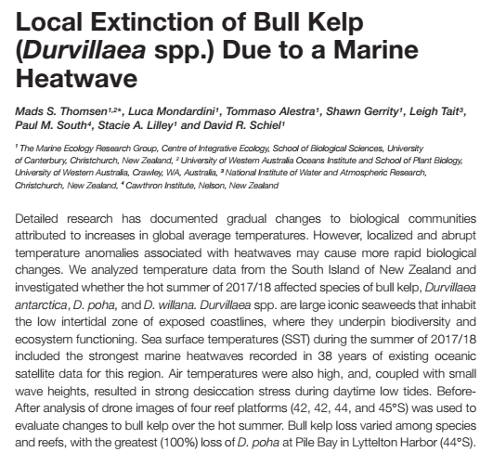
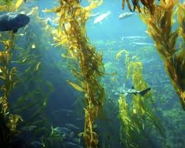
Localized and abrupt temperature increase have caused loss of bull kelp
Increased density of invasive species

Slide 14
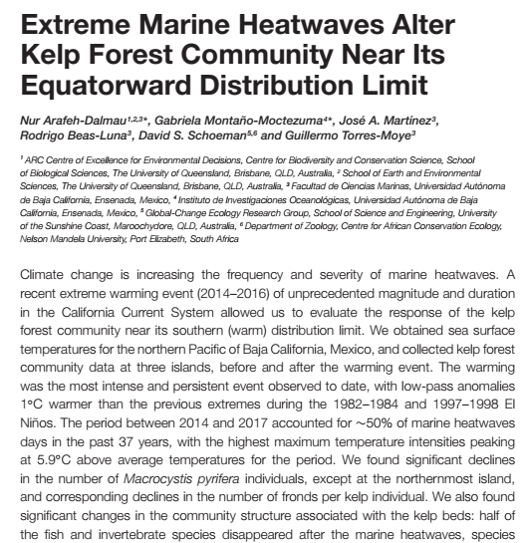
Marine heatwaves have caused reduction in kelp, and decrease in their fronds
Reduction in fish and invertebrates abundance

Slide 15
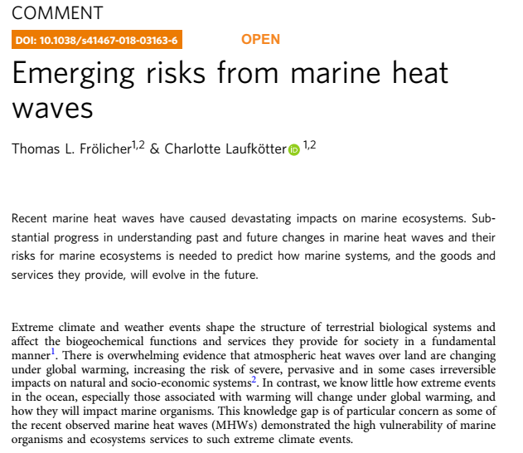
Geographical shifts – distribution of fish
Reduced abundance of seaweed, but increased in other species
Mortality of sea lions, whales, sea birds
Millions of dollars losses among fish industries

Slide 16
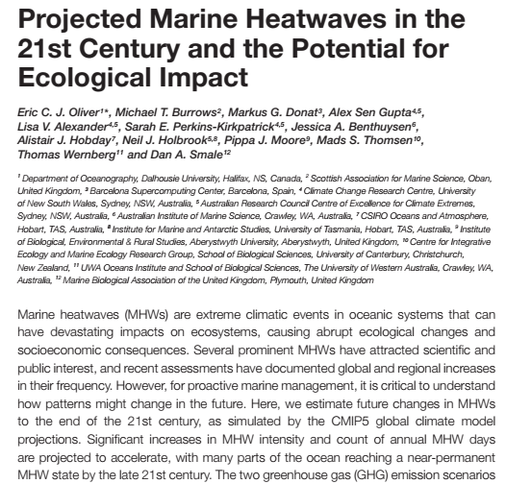
Studies have projected there will be:
Increase in the numbers and
Intensity of marine heatwaves

Slide 17
Threatens ocean lives
Affect plants, animals and microbes species - growth
Mass migration – search for right conditions for feeding and spawning
Alter breeding patterns
Threaten sensitive ocean life such as corals – stress and diseases
Change the frequency and intensity of harmful algal blooms such as “red tide”

Slide 18
Ocean circulation
Affect circulation patterns that bring nutrients from the deep sea to surface waters
Changes in reef habitat and nutrient supply could alter ocean ecosystems and lead to declines in fish populations
Affect people who depend on fishing for food or jobs – fish is important protein source

Slide 19
Global climate
Changes in sea surface temperature have profound effects on global climate
Increases in sea surface temperature - cause increase amount of atmospheric water vapor over the oceans
This water vapor feeds weather systems that produce precipitation, increasing the risk of heavy rain and snow

Slide 20
& extreme weather
Changes in sea surface temperature can shift storm tracks, potentially contributing to droughts in some areas
Other: Lengthen growth season for certain bacteria that can contaminate seafood and cause food-borne illnesses, thereby increasing the risk of health effects

Slide 21
SEA LEVEL
When averaged over all of the world’s oceans, absolute sea level has risen at an average rate of 0.15 cm per year from 1880 to 2013
Since 1993, average sea level has risen at a rate of 0.28 to 0.36 cm per year—roughly twice as fast as the long-term trend

Slide 22
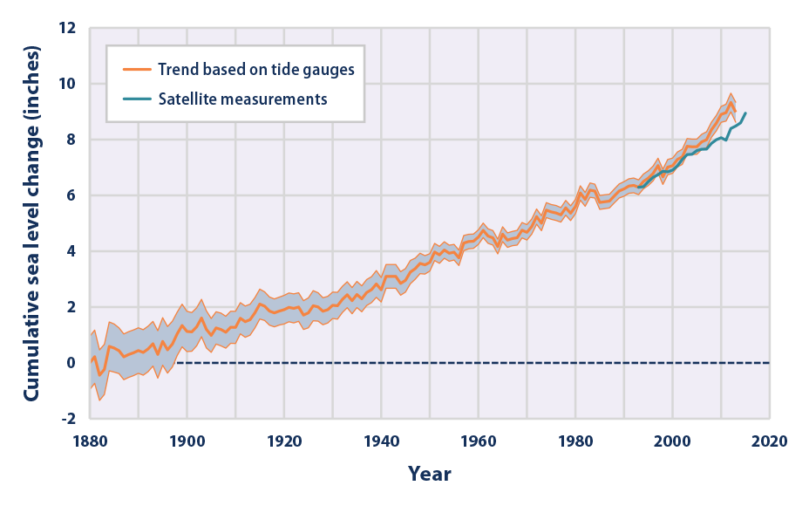

Slide 23
Threats of climate change to sea level:
When ice from land melts, it affects sea level
When water warms, it expands, thus affecting sea level

Slide 24
Effects of sea level rise:
(1) Flooding
More frequent; more locations
Coastal cities affected – huge loss
Inundate small islands
Survival of coastal wetlands (mangroves, salt marsh, sea grass) and habitats (turtle nesting)

Slide 25
Increased erosion
Worsen damage from hurricanes – huge damage
Increase migration – people are fleeing low lying areas
Seawater intrusion
Increases flow of salt water into estuaries and nearby groundwater aquifers
Destroy habitats
Threatens agriculture

Slide 26
Discussions – global warming
Causes | Effects
 | On Biodiversity | On Ocean | On Humans | On Weather

Slide 27
COASTAL FLOODING
Flooding - more frequent along coastline
Relative sea level change - height of the ocean relative to the land at a particular location
Sea level rises - one of the most noticeable consequences is increase in coastal flooding

Slide 28
Flooding usually occurs during high tides and storms
In recent years, coastal cities are increasingly flooding on days with less extreme tides or little wind, even on sunny days
Floods are happening more often because rising sea level reduces the gap between average sea level and the height of the land

Slide 29
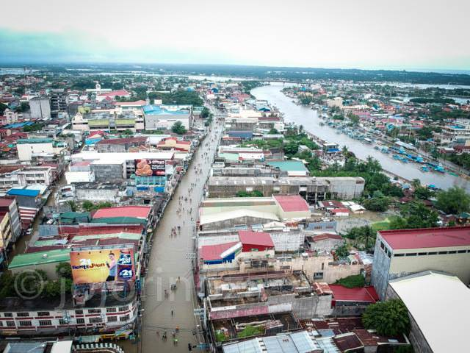
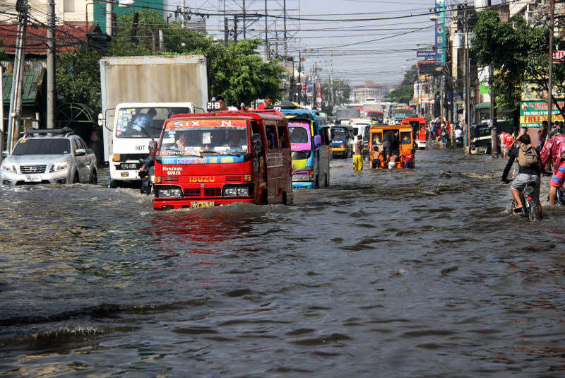
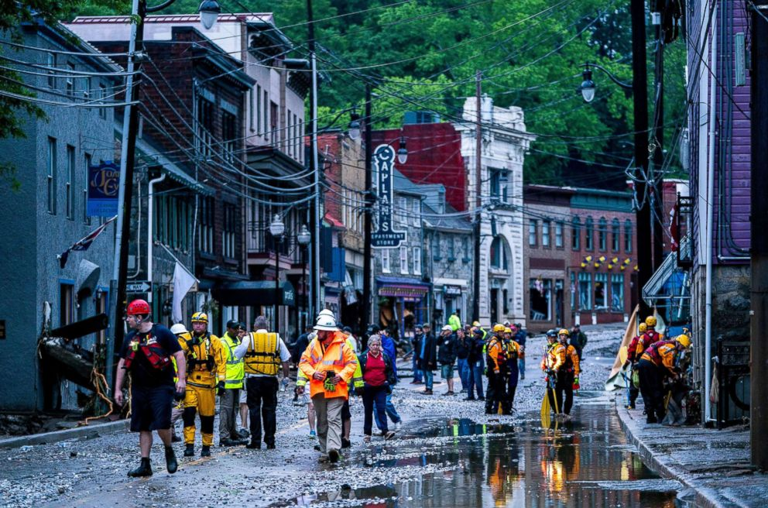
Minor flooding typically occurs in some streets, many storm drains become ineffective
Recurrent coastal flooding can cause impacts such as frequent road closures, reduced stormwater drainage capacity, and deterioration of infrastructure not designed to withstand frequent inundation or exposure to salt water.

Slide 30
These impacts are of particular concern – millions of people live in areas susceptible to coastal flooding, and more than trillions of property and structures is within a few feet of current sea level
Affect human health — increasing the risk that drinking water and wastewater infrastructure will fail; people at risk of exposure to pathogens and harmful chemicals

Slide 31
OCEAN ACIDIFICATION
ocean CO₂ levels have risen in response to increased CO₂ in the atmosphere
increase in acidity, decrease in pH

Slide 32
Dissolving CO₂ increases H⁺ ions:
CO₂ (aq) + H₂O H₂CO₃ HCO₃⁻ + H⁺ CO₃²⁻ + 2H⁺
Calcium carbonate reacts with acids, releasing CO₂:
CaCO₃(s) + 2H⁺(aq) Ca²⁺(aq) + CO₂(g) + H₂O(l)

Slide 33
Increased CO₂ has led to lower aragonite saturation levels in the oceans
More difficult for certain organisms to build and maintain their skeletons and shells.
The largest decreases in aragonite saturation have occurred in tropical waters
Decreases in cold areas may be of greater concern because colder waters typically have lower aragonite saturation levels to begin with

Slide 34
Rising levels of carbon dioxide dissolved in the ocean can have a negative effect on some marine life
CO₂ reacts with sea water to produce carbonic acid
The resulting increase in acidity (measured by lower pH values) changes the balance of minerals in the water

Slide 35
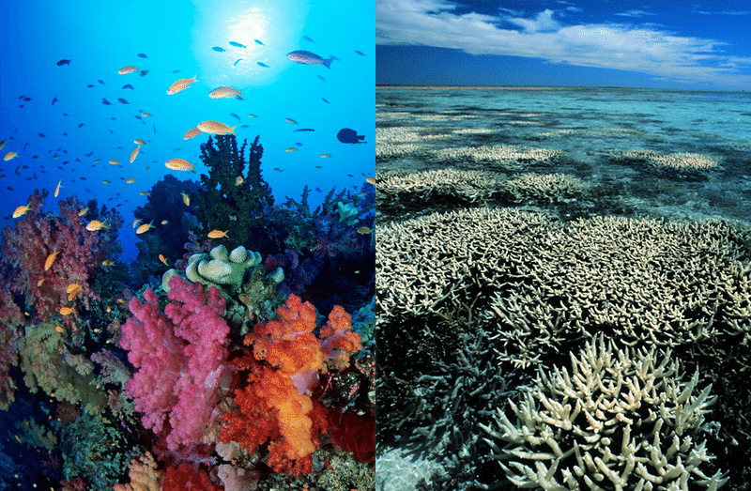
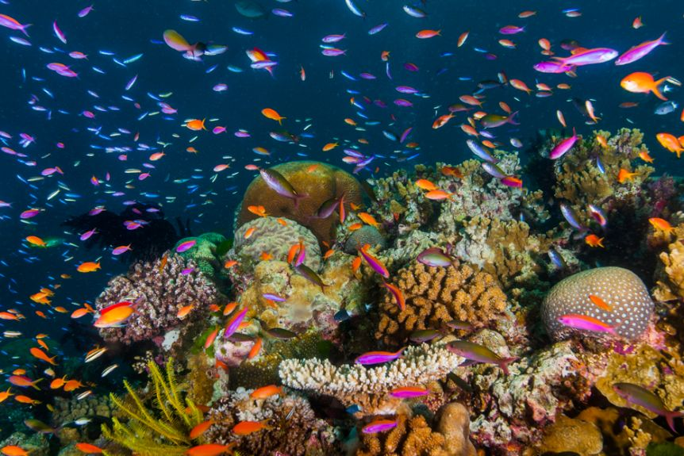
More difficult for corals, some types of plankton, and other creatures to produce a mineral called calcium carbonate, which is the main ingredient in their hard skeletons or shells.
Can ultimately affect fish populations and the people who depend on them

Slide 36
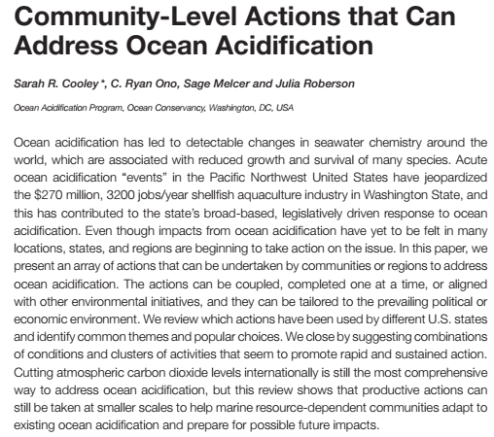

Slide 37
HYPOXIA
Low or O₂ depletion in water
Human activities, excess nutrients, warmer water
Algae bloom causes O₂ depletion when algae sink to bottom and decompose
Harmful algae bloom produce toxin

Slide 38
106 CO₂ + 122 H₂O + 16 HNO₃ + H₃PO₄ (CH₂O)₁₀₆(NH₃)16H₃PO₄ + 138 O₂
photosynthesis
(CH₂O)₁₀₆(NH₃)16H₃PO₄ + 138 O₂ 106 CO₂ + 122 H₂O + 16 HNO₃ + H₃PO₄
respiration

Slide 39
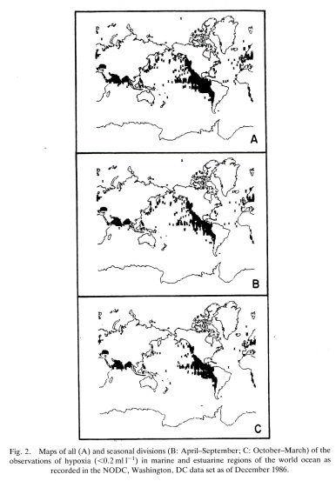
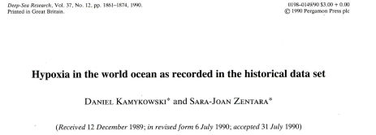
(1) What is the trend of these figures?
(2) Explain why.

Slide 40
BIODIVERSITY LOSS
Water temperatures warming
Zooplankton species like Calanus finmarchicus, a critical food supply, have changed their migration patterns
Whales follow their prey out of their migration route- danger to ship strikes

Slide 41
Distribution of parasites and pathogens will be affected by global warming
Transmission rates of parasites and pathogens are directly correlated to temperature, increasing temperature is increasing transmission rate

Slide 42
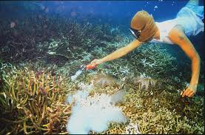
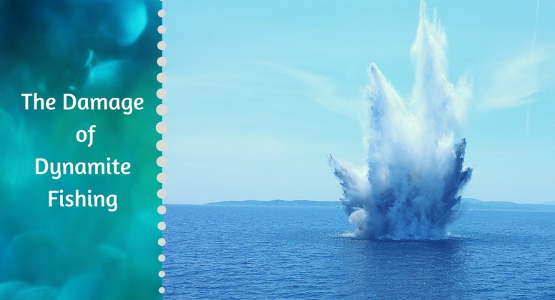
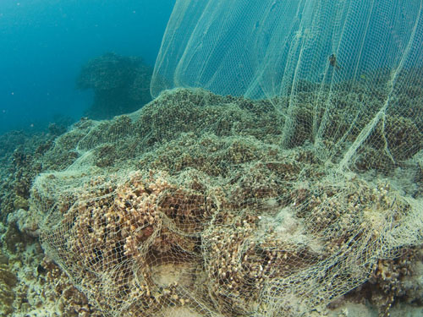
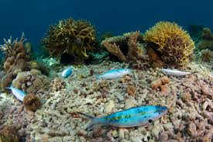
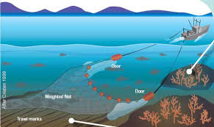
CORAL REEFS
Coral reefs support marine life and provide ecosystem services to people
Threats: overfishing, pollution, ocean acidification, methods of fishing

Slide 43
Cyclone – more intense, destruct coral reefs
Threats from water quality and fishing, but mainly increased temperature
Marine protected areas have been established to protect coral reefs and fish – these strategies have little effect as main stressor is rising ocean temperature

Slide 44
ARCTIC
Rapid warming affects food web
Species migrate northward from Pacific and Atlantic – disrupt ecosystem and lifestyles
High pollution

Slide 45
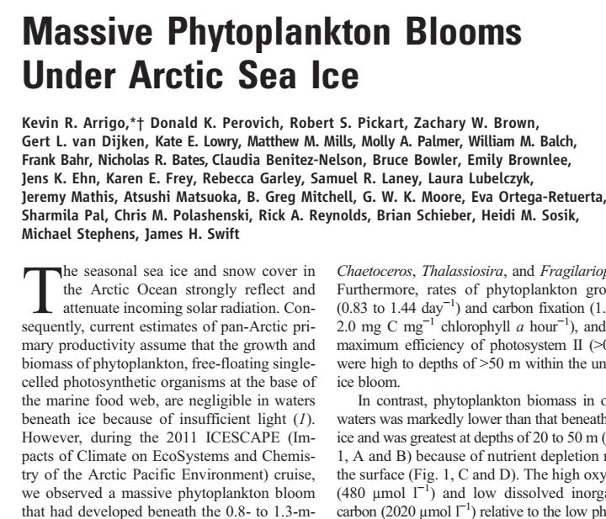

Slide 46
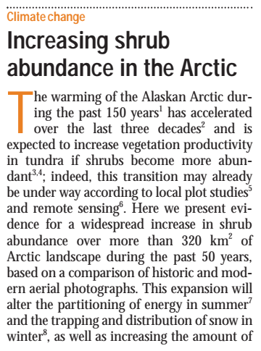
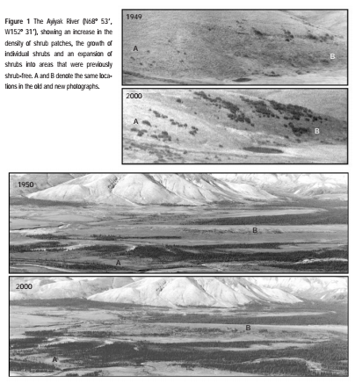

Slide 47
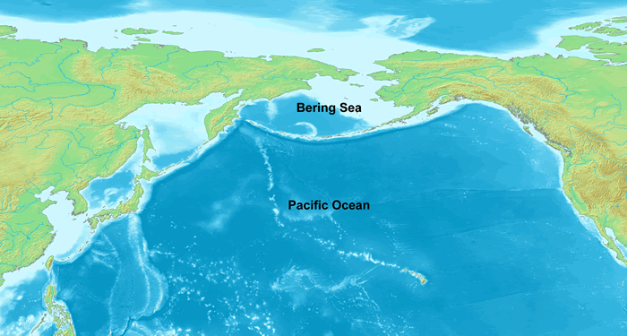
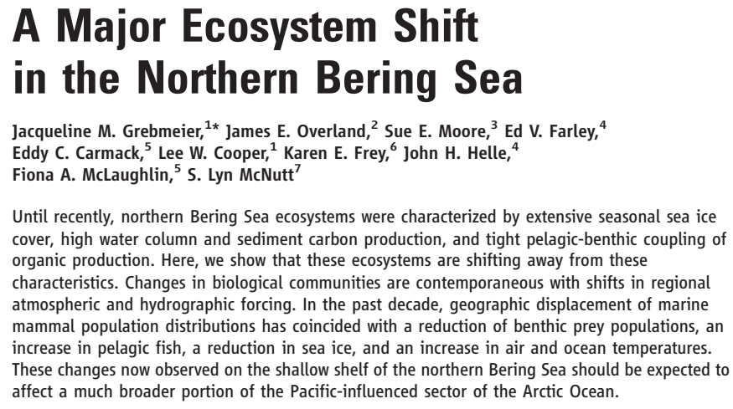

Slide 48
discussions
Give an example of the impact of climate change (or human activities) on the ocean
Please explain how we are responding to this threat as a:
Community (universities)
Community (villages)
Government/country
International

Slide 49
References
Arafeh-Dalmau et al. 2019. Extreme marine heatwaves alter kelp forest community near its equatorial distribution limit. Frontiers in Marine Science 6, 499.
Arrigo et al. 2012. Massive phytoplankton blooms under Arctic sea ice. Science 336, 1408.
Cooley et al. 2016. Community-level actions that can address ocean acidification. Frontiers in Marine Science 2, 128.
Dow K & Downing TE. 2011. The Atlas of Climate Change. Earthscan
Frolicher TL & Laufkotter C. 2018. Emerging risks from marine heat waves. Nature Communications 9, 650.
Grebmeier et al. 2006. A major ecosystem shift in the northern Bering Sea. Science 311, 1461.

Slide 50
Kamykowski D & Zentara S-J. 1990. Hypoxia in the world ocean as recorded in the historical data set. Deep-Sea Research 37(12), 1861-1874.
Meyssignac et al. 2019. Measuring global ocean heat content to estimate the Earth Energy Imbalance. Frontiers in Marine Science 16, 432.
Oliver et al. 2019. Projected marine heatwaves in the 21st century and the potential for ecological impact. Frontiers in Marine Science 6, 734.
Schiermeier et al. 2018. Great Barrier Reef saw huge losses from 2016 heatwave. Nature 556, 281.
Sturm et al. 2001. Increasing shrub abundance in the Arctic. Nature 411, 546.
Thomsen et al. 2019. Local extinction of bull kelp (Duvillaea spp.) due to a marine heatwave. Frontiers in Marine Science 6, 84.
https://simple.wikipedia.org/wiki/Climate
https://en.wikipedia.org/wiki/Cliamte_change(general_concept)
https://www.epa.gov/climate-indicators/oceans
https://oceanfdn.org/ocean-and-climate-change/

Slide 51
Thank you!
See you all next week!

